Slide 1


Slide 2
Charte Visuel

Slide 3


LOGO

Slide 4
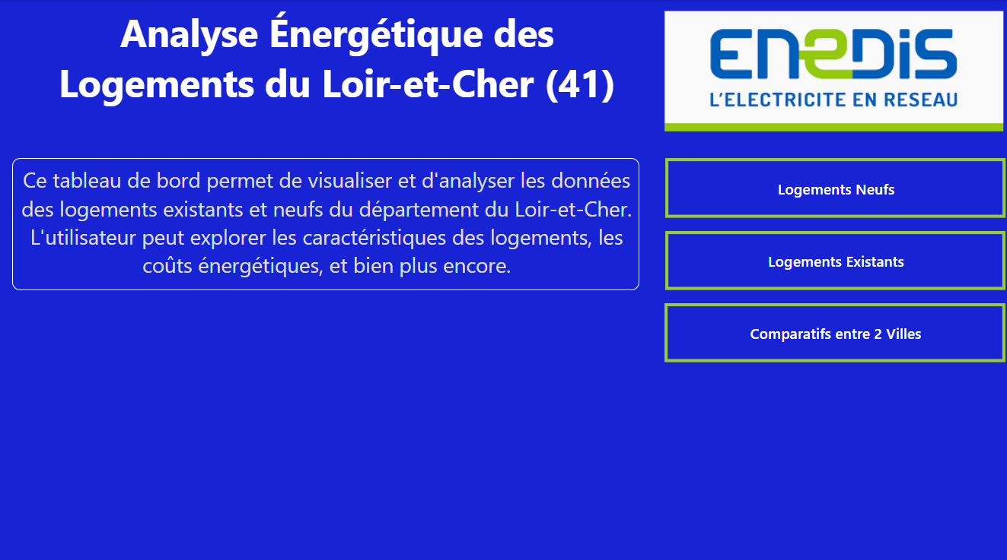
Maquette page acceuil

Slide 5
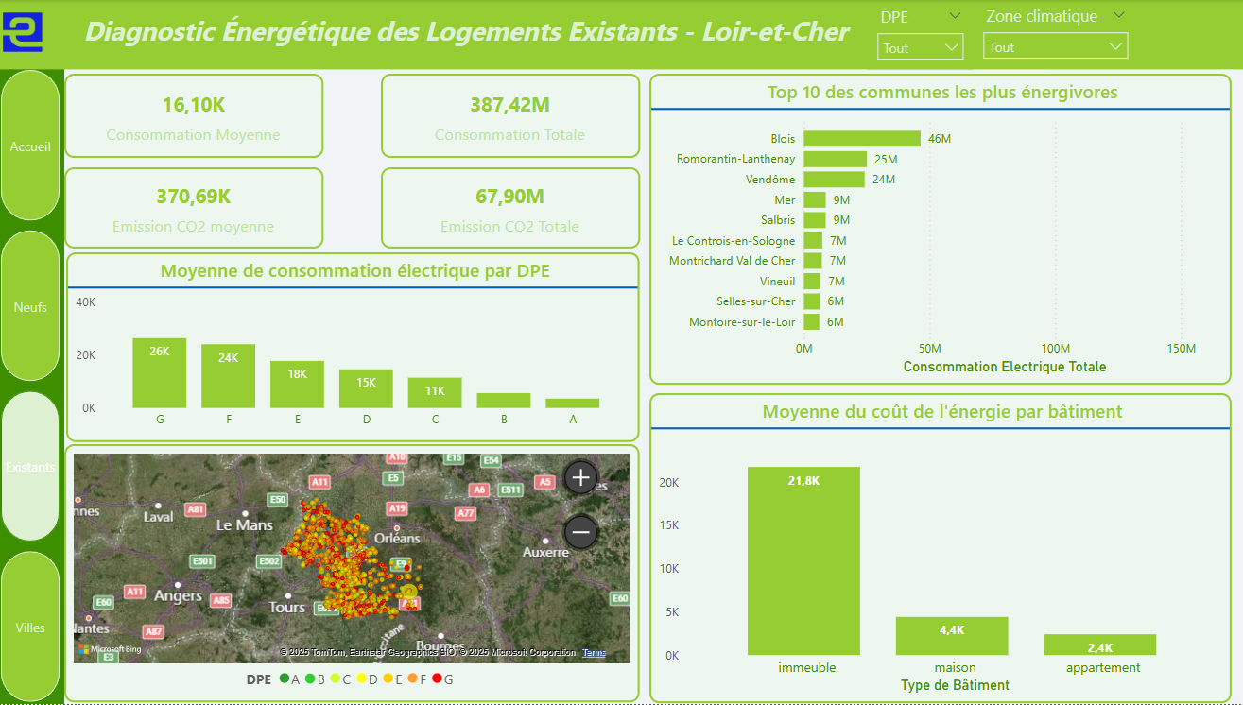
Maquette Page Existant

Slide 6
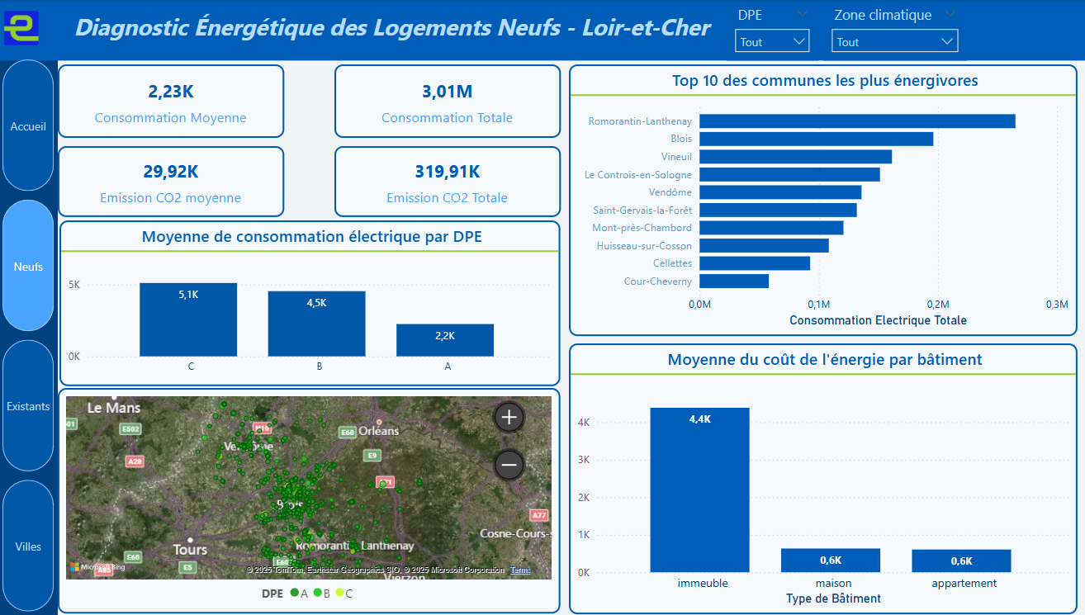
Maquette Page Neuf

Slide 7
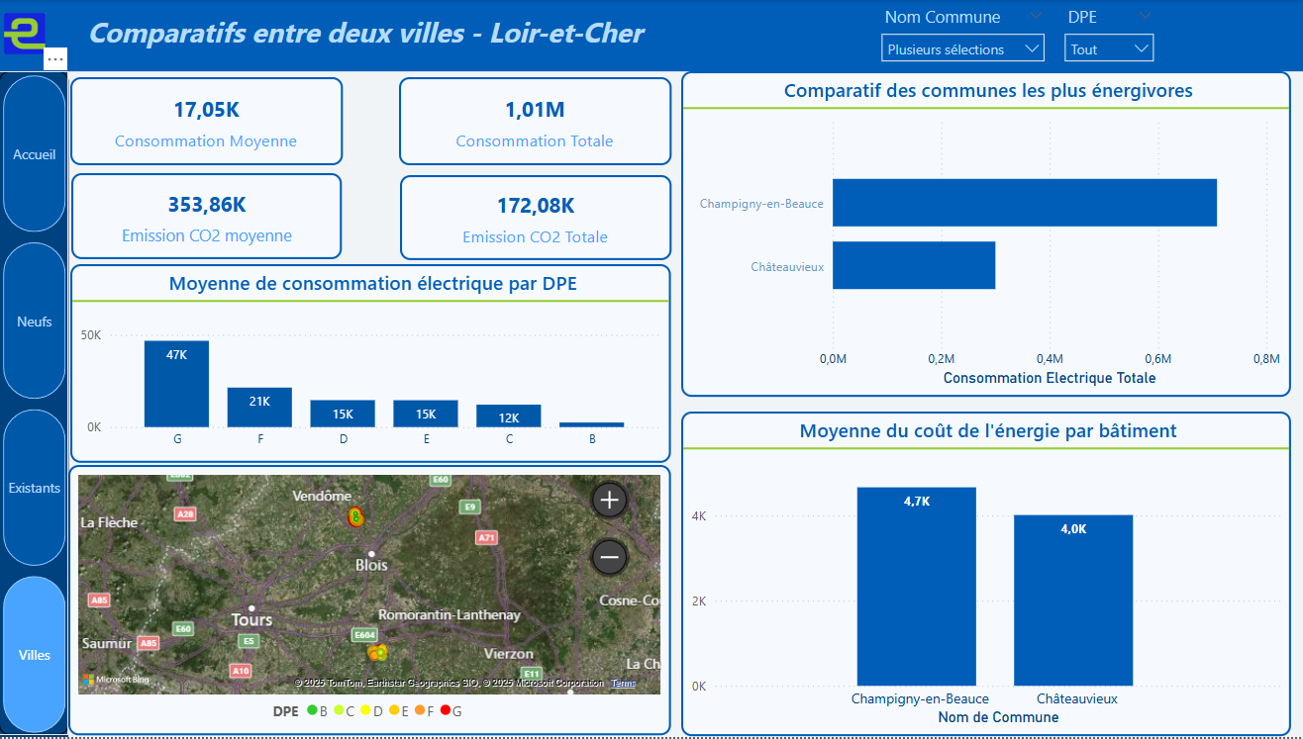
Maquette Page comparaison

Slide 8
LIEN CANVA :https://www.canva.com/design/DAGdOWDk8wA/VD-6lT3YEErdIxxhLQiuDQ/edit?utm_content=DAGdOWDk8wA&utm_campaign=designshare&utm_medium=link2&utm_source=sharebutton

